Slide 1
Composite (Fiberglass) Pole Installation Debrief
October 31, 2023
Technical Services / Distribution Standards | William Tate, Michael Keller

Slide 2
Why are we here talking today
Provide an overview on the status of Fiberglass poles at PECO
Fiberglass poles speaks to the Innovation needed to rebuild our grid. The current supply of wood poles can not support the need to grow.
There are many pros and cons to this transition: Engineering, Supply, Safety, Methods, Tools and most important by in and understanding what the field crews will need to make this a success.
Where do Fiberglass poles fit? (tangent poles, transformer poles, guying issues, cable installations, rear property).
We need to walk before we run when comparing them to using wood poles.

Slide 3
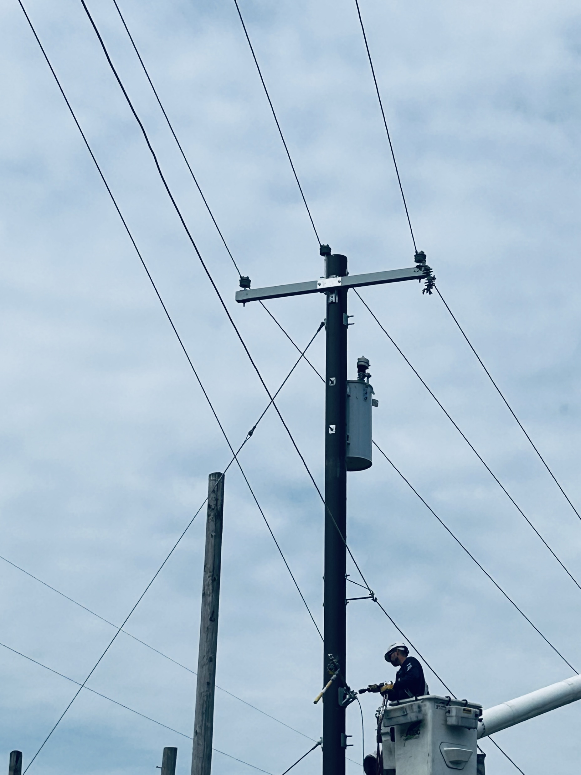
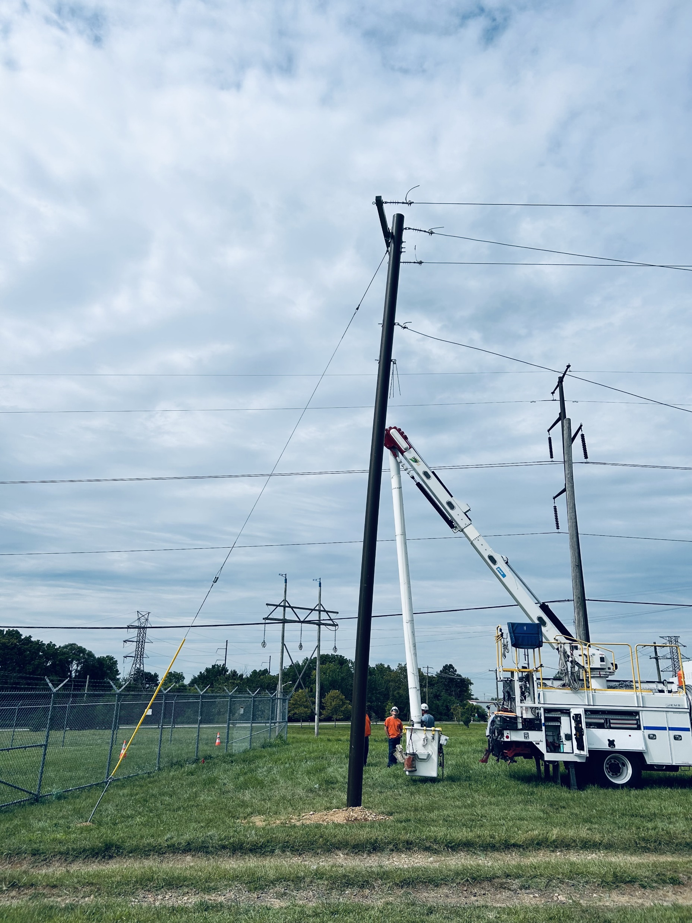
Agenda
Background
Engineering Specifications
Safety
Methods - Tools
Supply
Change Management
Open Discussions

Slide 4
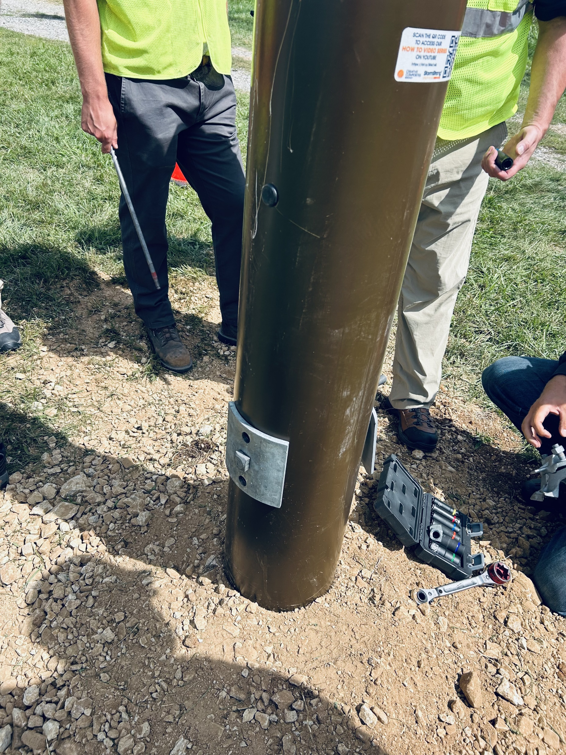
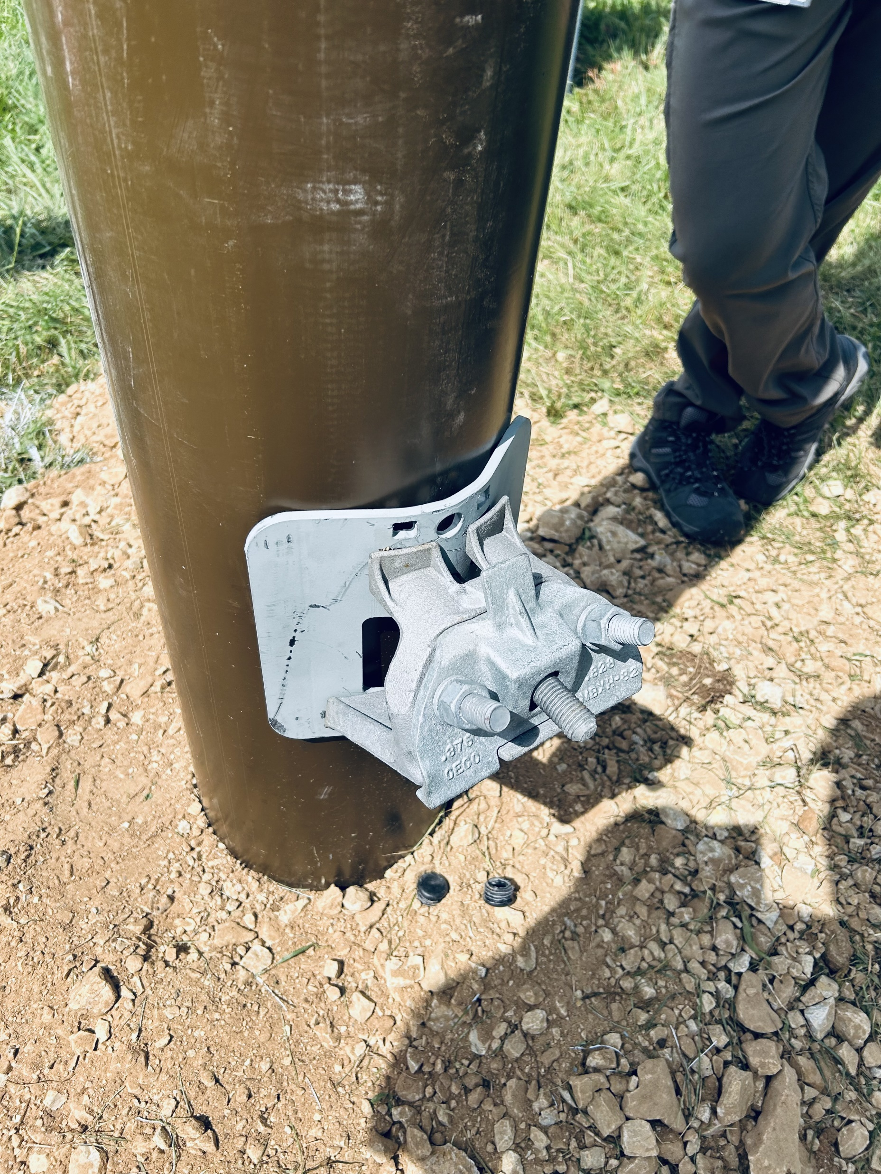
Background
Increased demand for Class 2 wood poles has caused an issue in supply chain.
Trees used to produce utility poles take time to grow. Heavier class poles (Class 2 or stronger) take a longer time to produce.
Increasing framing lumber prices has resulted in timber being cut early to take advantage of higher prices, which ultimately decreases availability of heavy class poles.
Supply shortage of Class 2 poles resulted in PECO looking at alternative pole material
PennDOT has requirements regarding types of poles (no steel) allowed near roadways
Pros of Composite (Fiberglass) Poles
Engineered product with lighter weight and longer expected lifespans
Non-conductive
Resistant to rot, pests, woodpeckers, etc.
Do not require any toxic chemicals as preservative
Composite poles may cost 3 times cost of wood poles

Slide 5
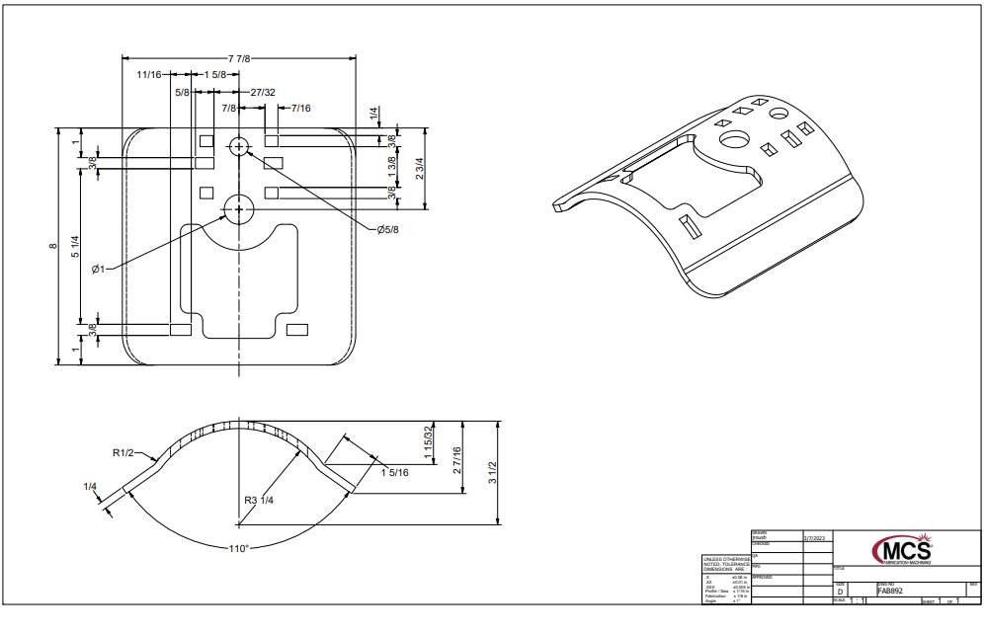
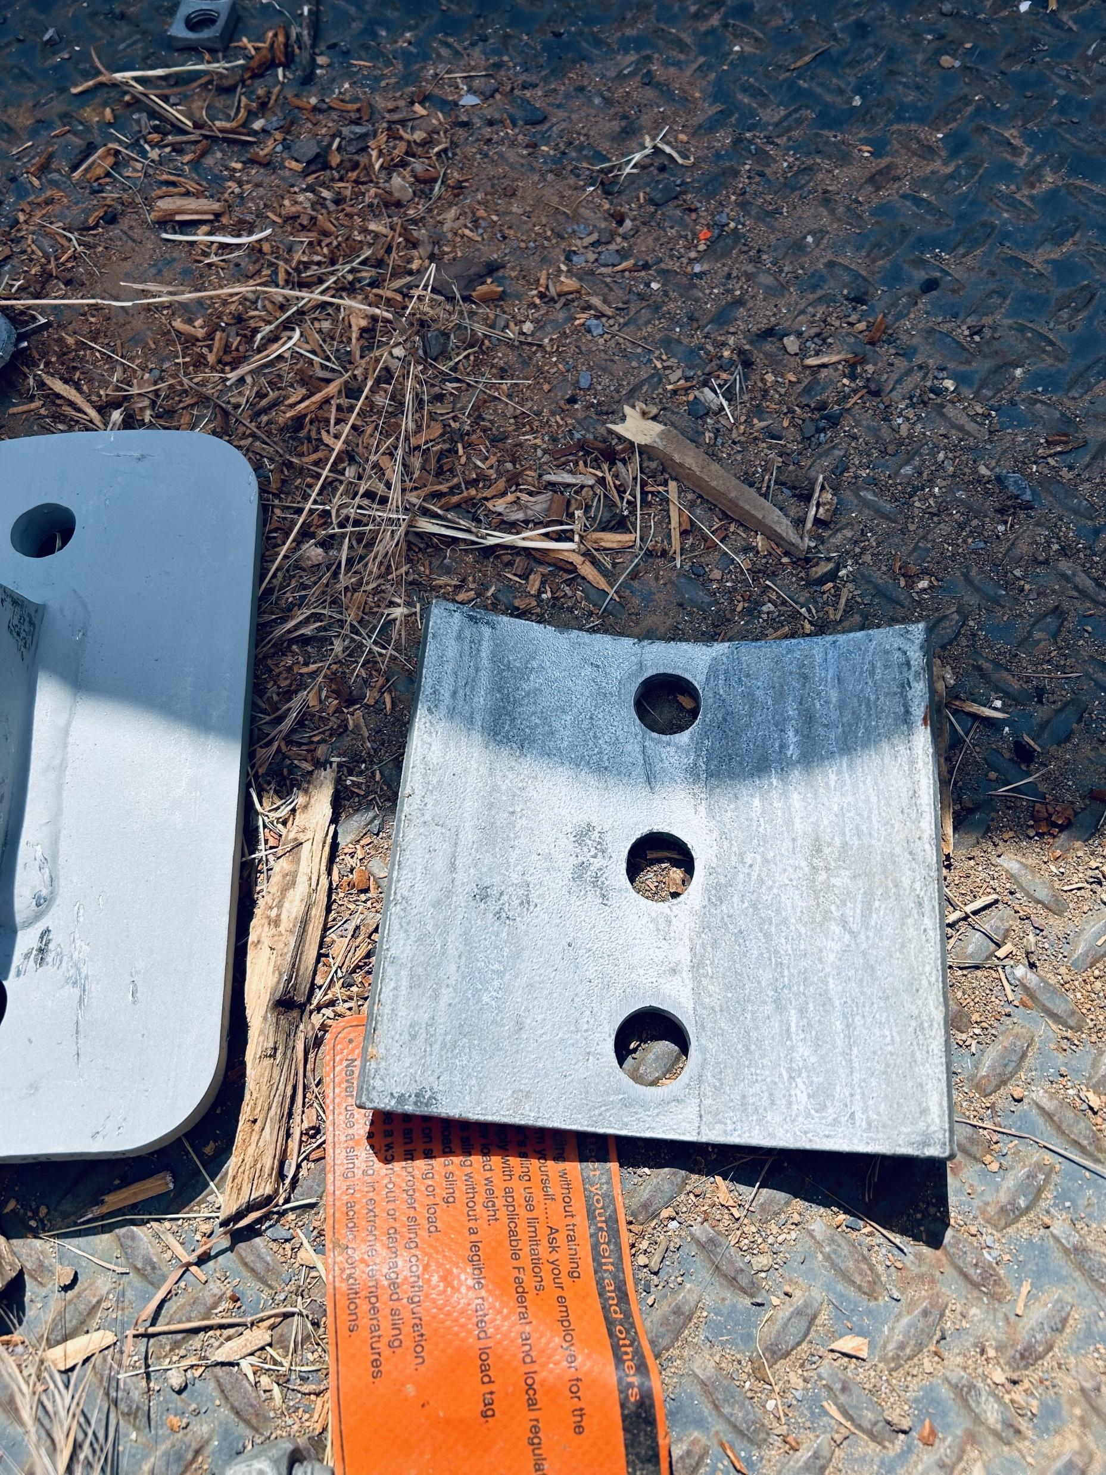
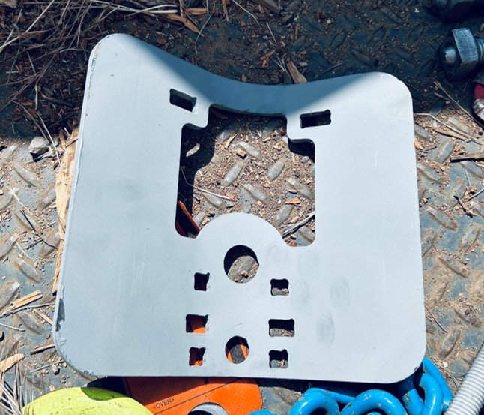
Engineering Specifications
Composite (fiberglass) pole material specification created
PECO Design Standard created “Attaching PECO Facilities to Version Composite (Fiberglass) poles.
Defines limits on positioning of bolt holes
Incompatible hardware
New hardware
Standard hardware for transformers is acceptable.
Bolted connections require curved washers beneath both bolt head and nuts
Engineering worked with manufactures to design and build specialty curved washers for typical hardware with cleats, teeth or spurs.
Two 45’ class 2 fiberglass poles were set at PECO’s line school for learnings.

Slide 6
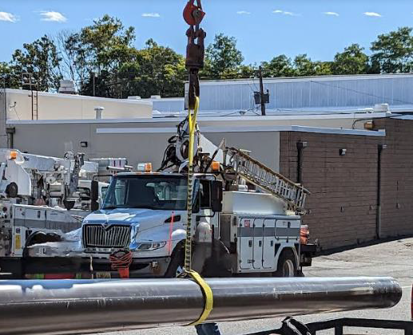
Methods and Tools
New longer drill bits will are needed 22 inch
Drill jigs are not required
New saw blades will be coded
New composite pole slings are required (rubber grips)
New pole hooks are required
Retraining on tightening hardware is required, tightening only required to compress the spring washers. Over tightening can damage the pole
Procedure needed for handling, transporting and placing composite poles

Slide 7
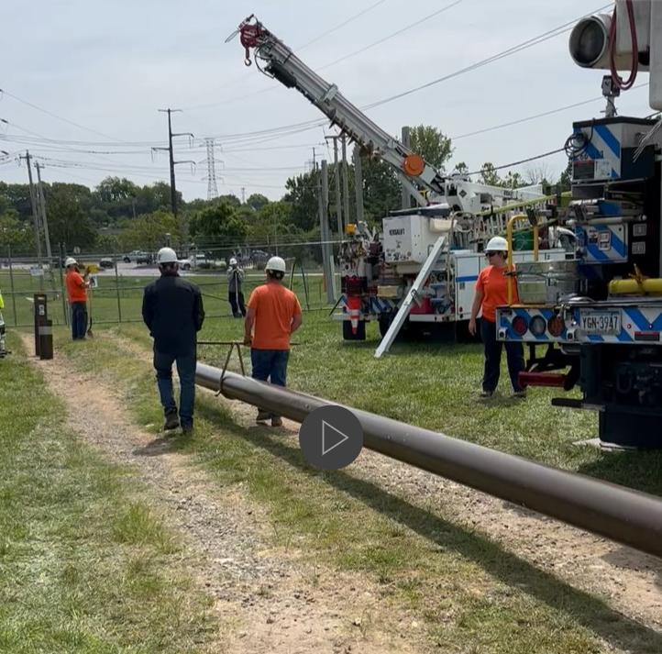
Supply
PECO Supply is working with Engineering to put out an RPF to suppliers that meet our specifications.
Verizon has started using fiberglass poles. 45 class 2 poles, 10-inch dia.)
PSE&G in NJ is purchasing fiberglass poles.
Price is currently times wood poles.

Slide 8
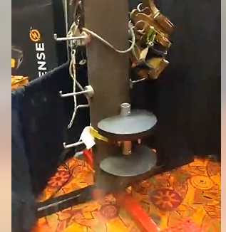
Safety
Working to find a FR rated N95 mask if poles need to be cut in the MAD
Verizon crews did not use them and were not required, the dust is considered nuisance only
Working and climbing from pole steps is under review.
New technology possibilities: Fiber pole step by ESP

Slide 9
Safety
Working to find a FR rated N95 mask if poles need to be cut in the MAD
Verizon crews did not use them and were not required, the dust is considered nuisance only
Working and climbing from pole steps is under review.
New technology possibilities: Fiber pole step by ESP

Slide 10
Open Discussions
PECO Real Estate and Facilities - Reviewing the current pole agreement with Verizon.
Monthly meetings are scheduled with Verizon to discuss issues.
Supply - Working with our pole vender on an agreement to deliver fiberglass poles.
Everyone - Support Needed:
Rollout and change management
Senior management engagement

Slide 11
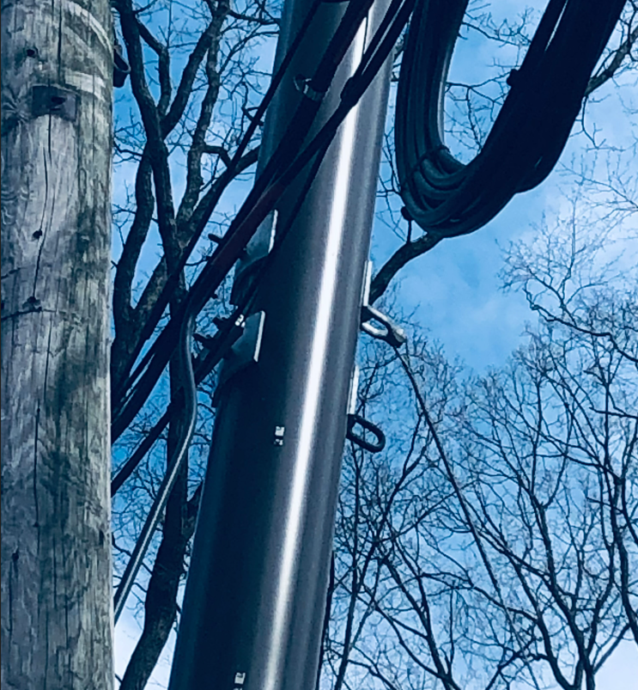
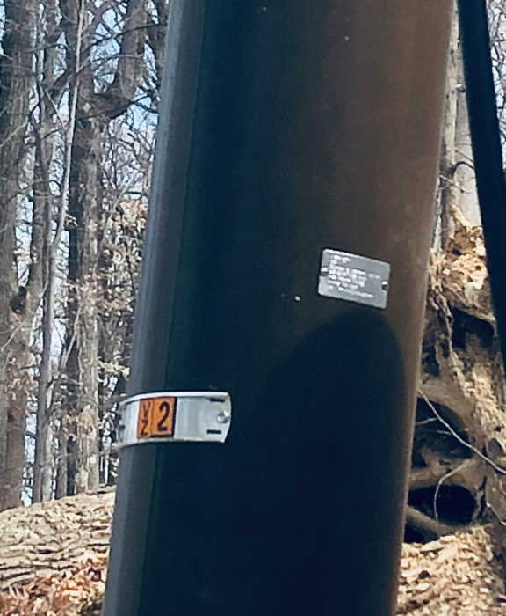
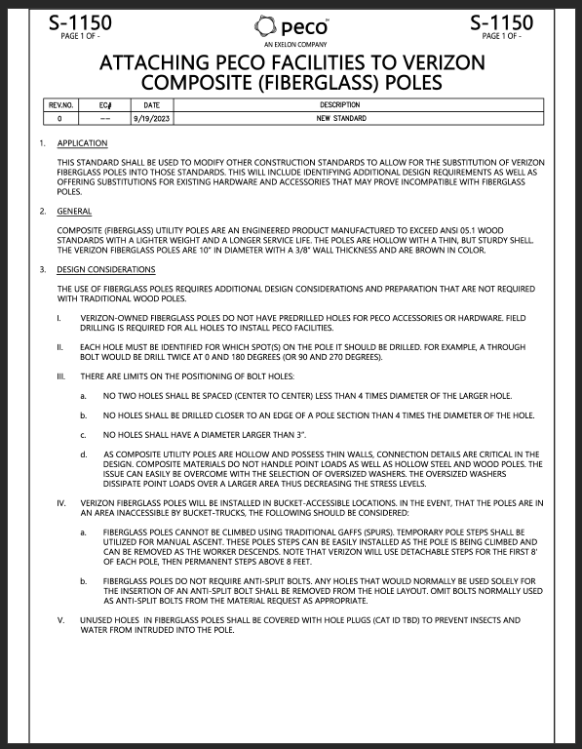
Appendix
Guidelines for Attaching PECO Facilities to Verizon Composite (Fiberglass) Poles
Draft
Poles set by Verizon for a PECO cable project.

Slide 12
Fiberglass Pole Demo
Installed At
Plymouth Line School

Slide 13
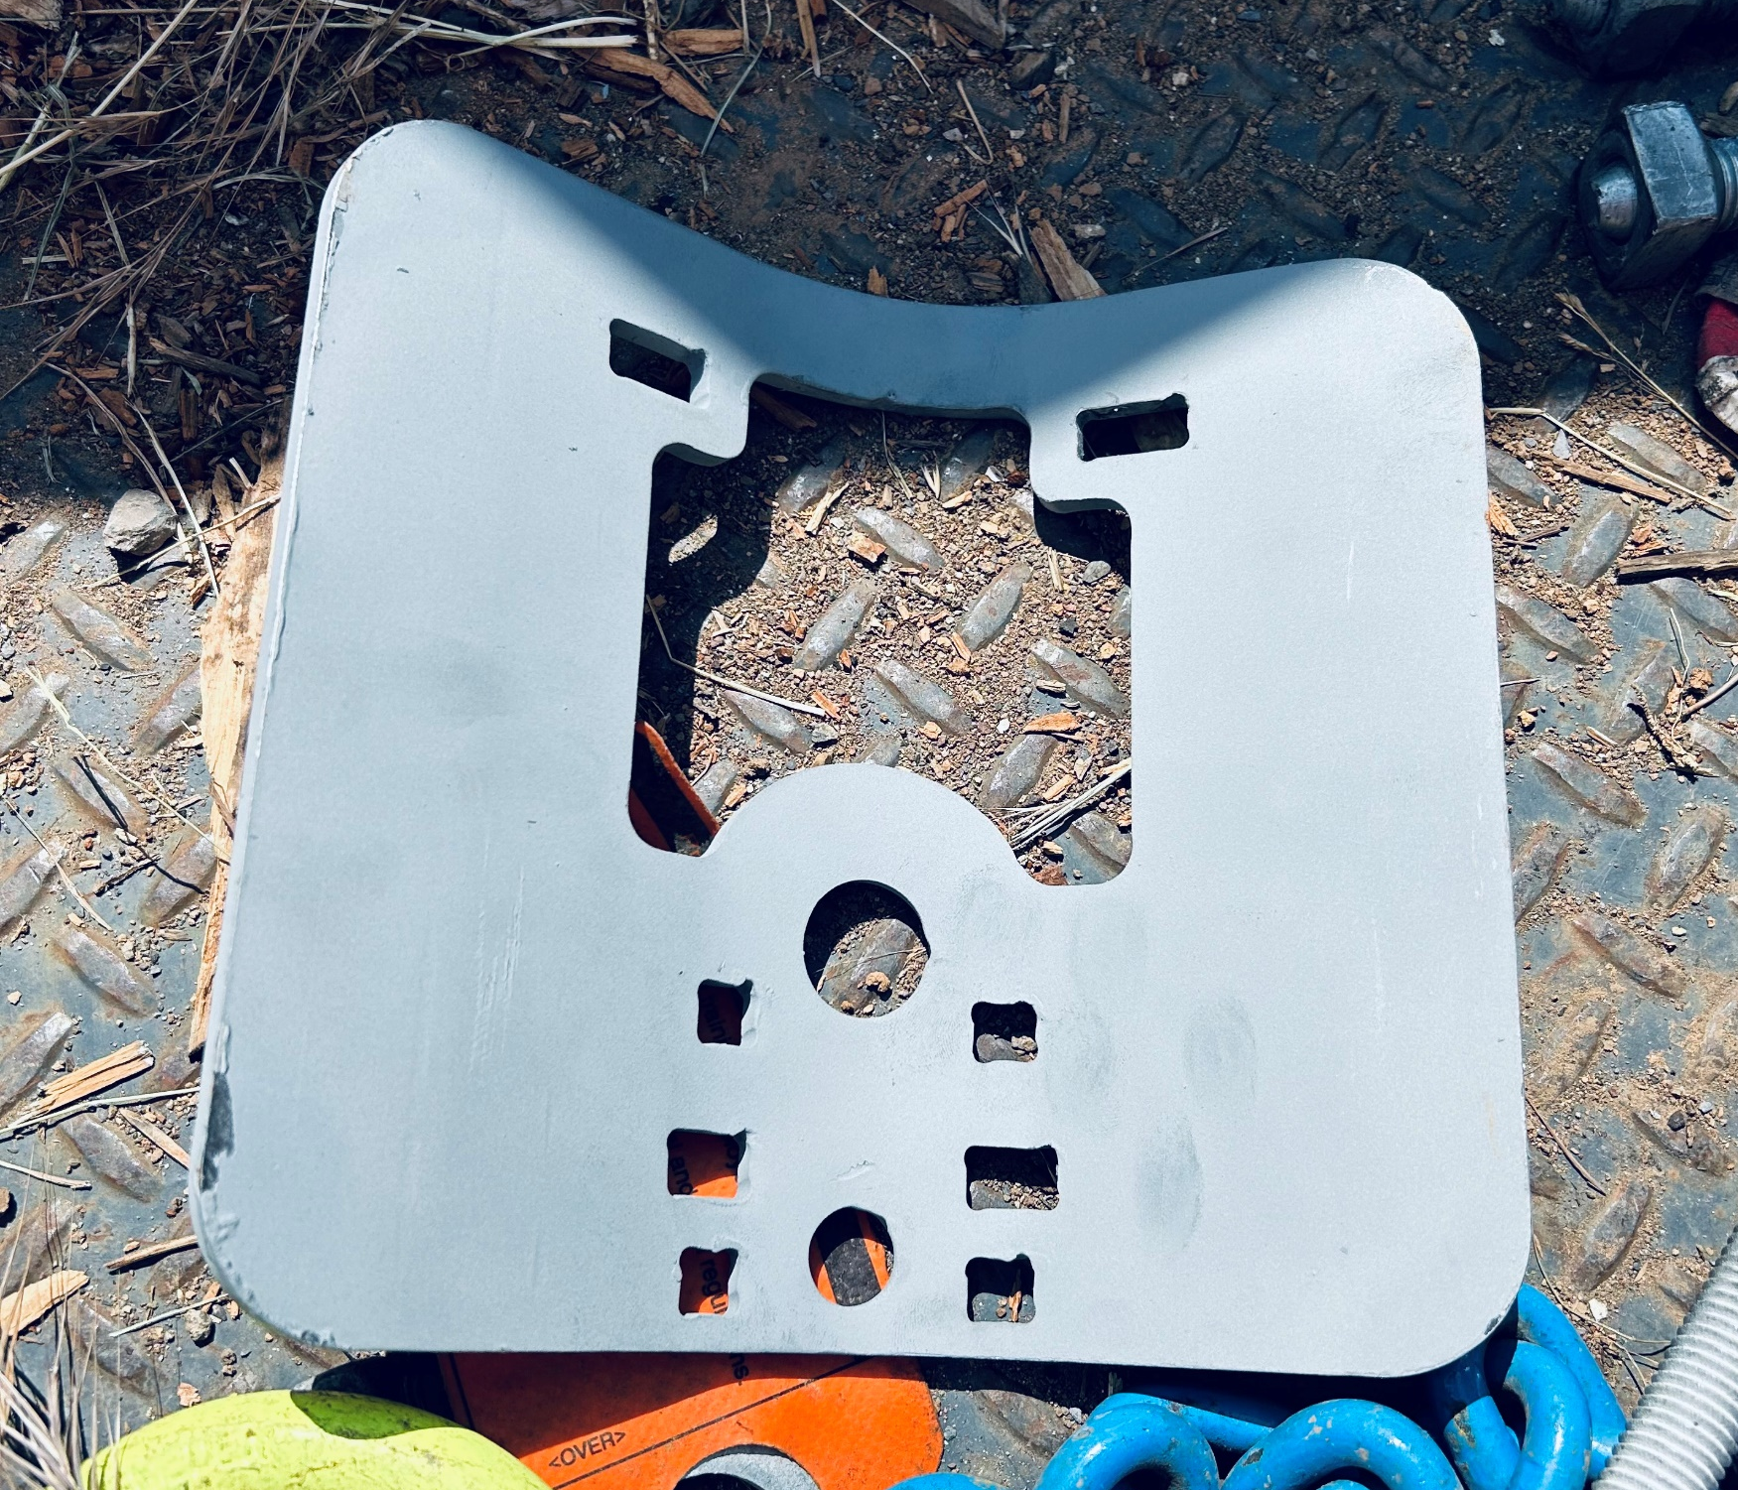
Standards designed new hardware to accept existing cable bracket plate

Slide 14
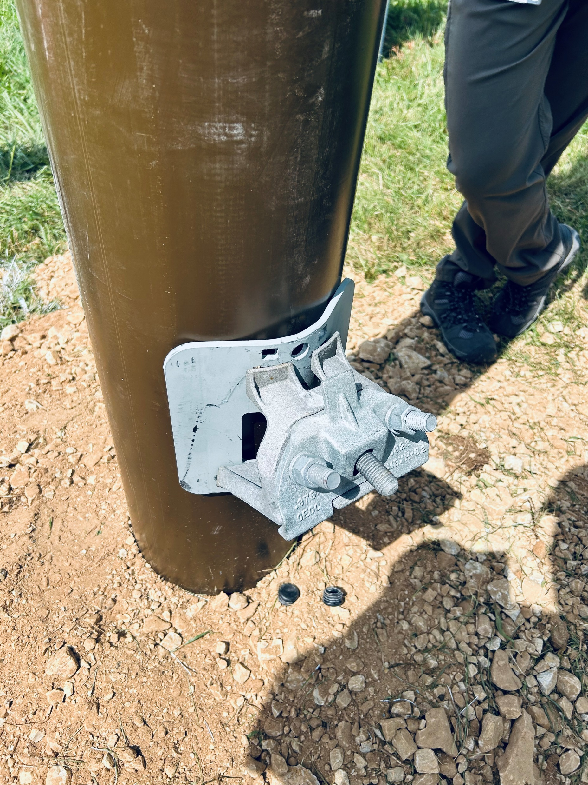
New plate with existing cable bracket, bracket cleats won’t damage the fiberglass pole

Slide 15
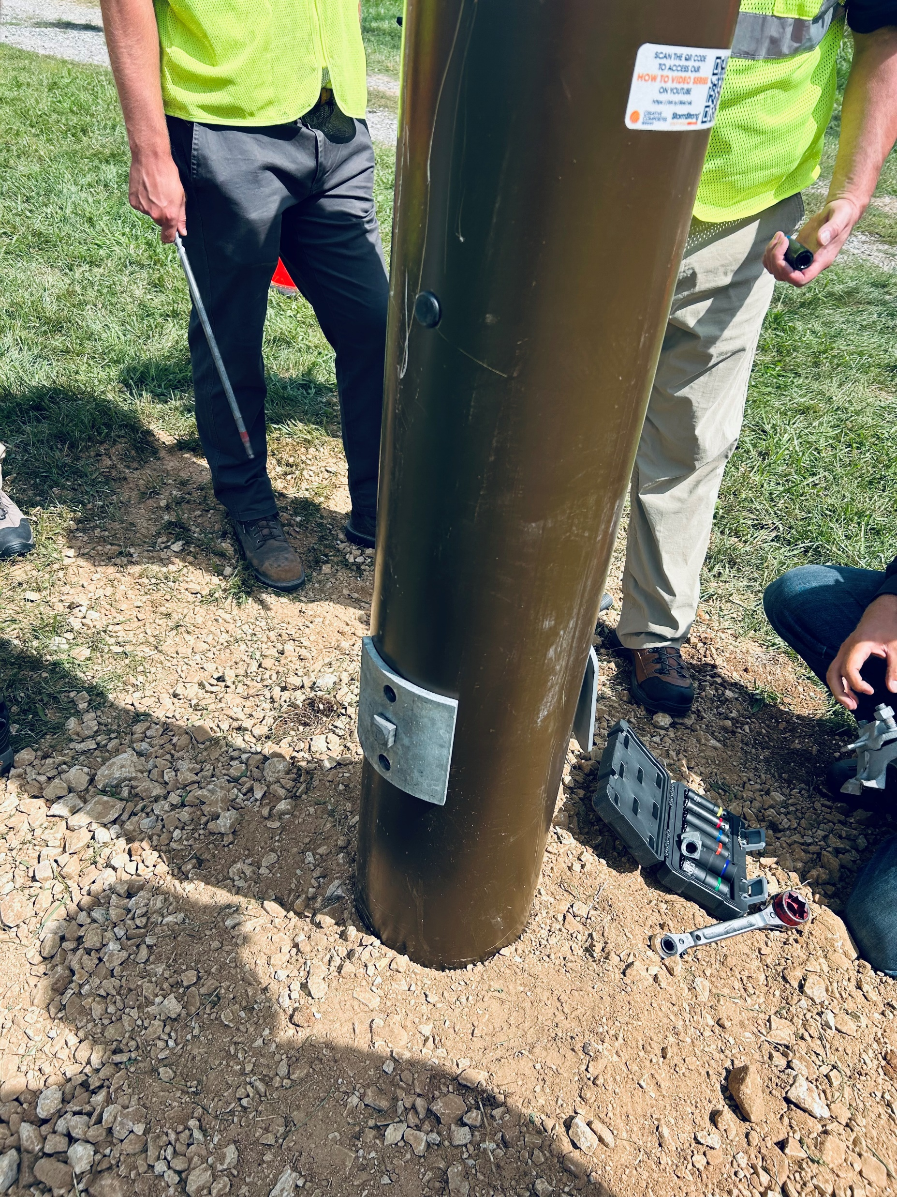
Standards engineered new 3-inch washers to be used for all guying applications on fiberglass pole

Slide 16
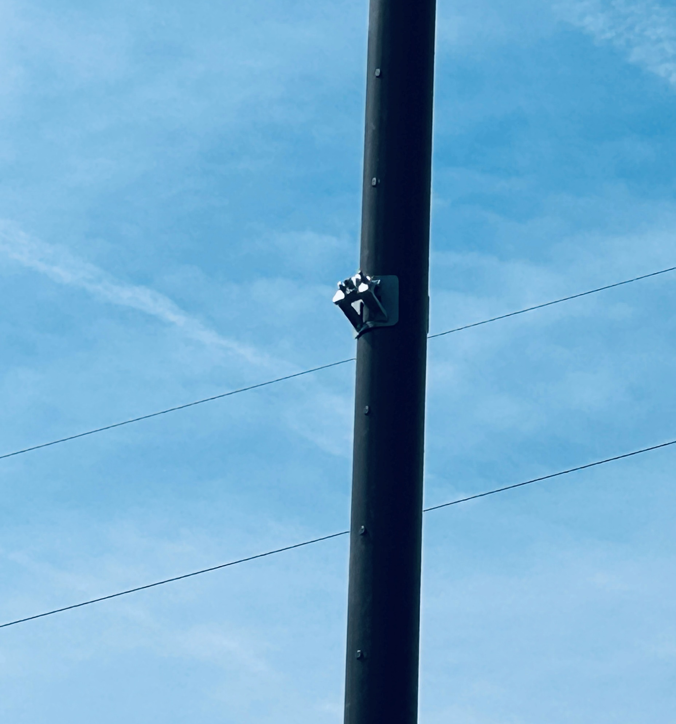
Final placement on the pole - ready for cable messenger

Slide 17
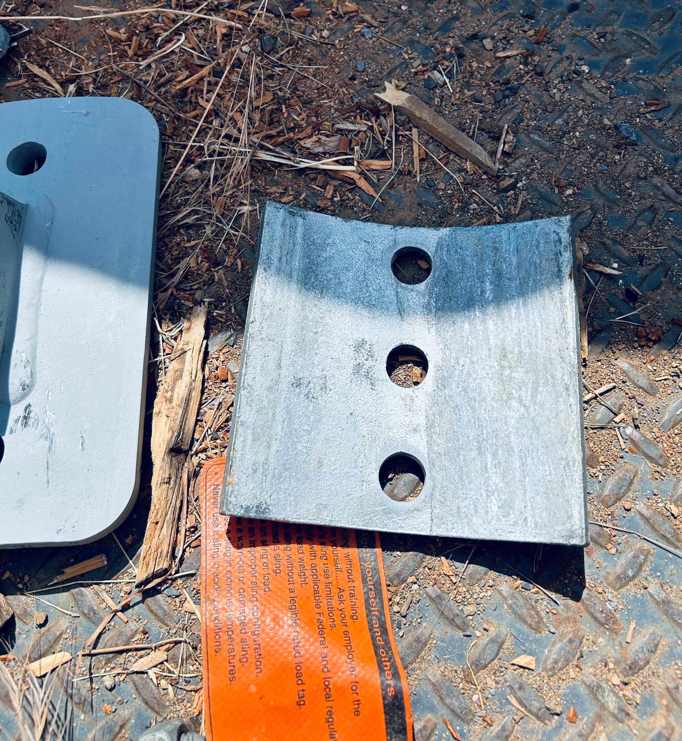
New 3-inch round washers to be used for all guying applications

Slide 18
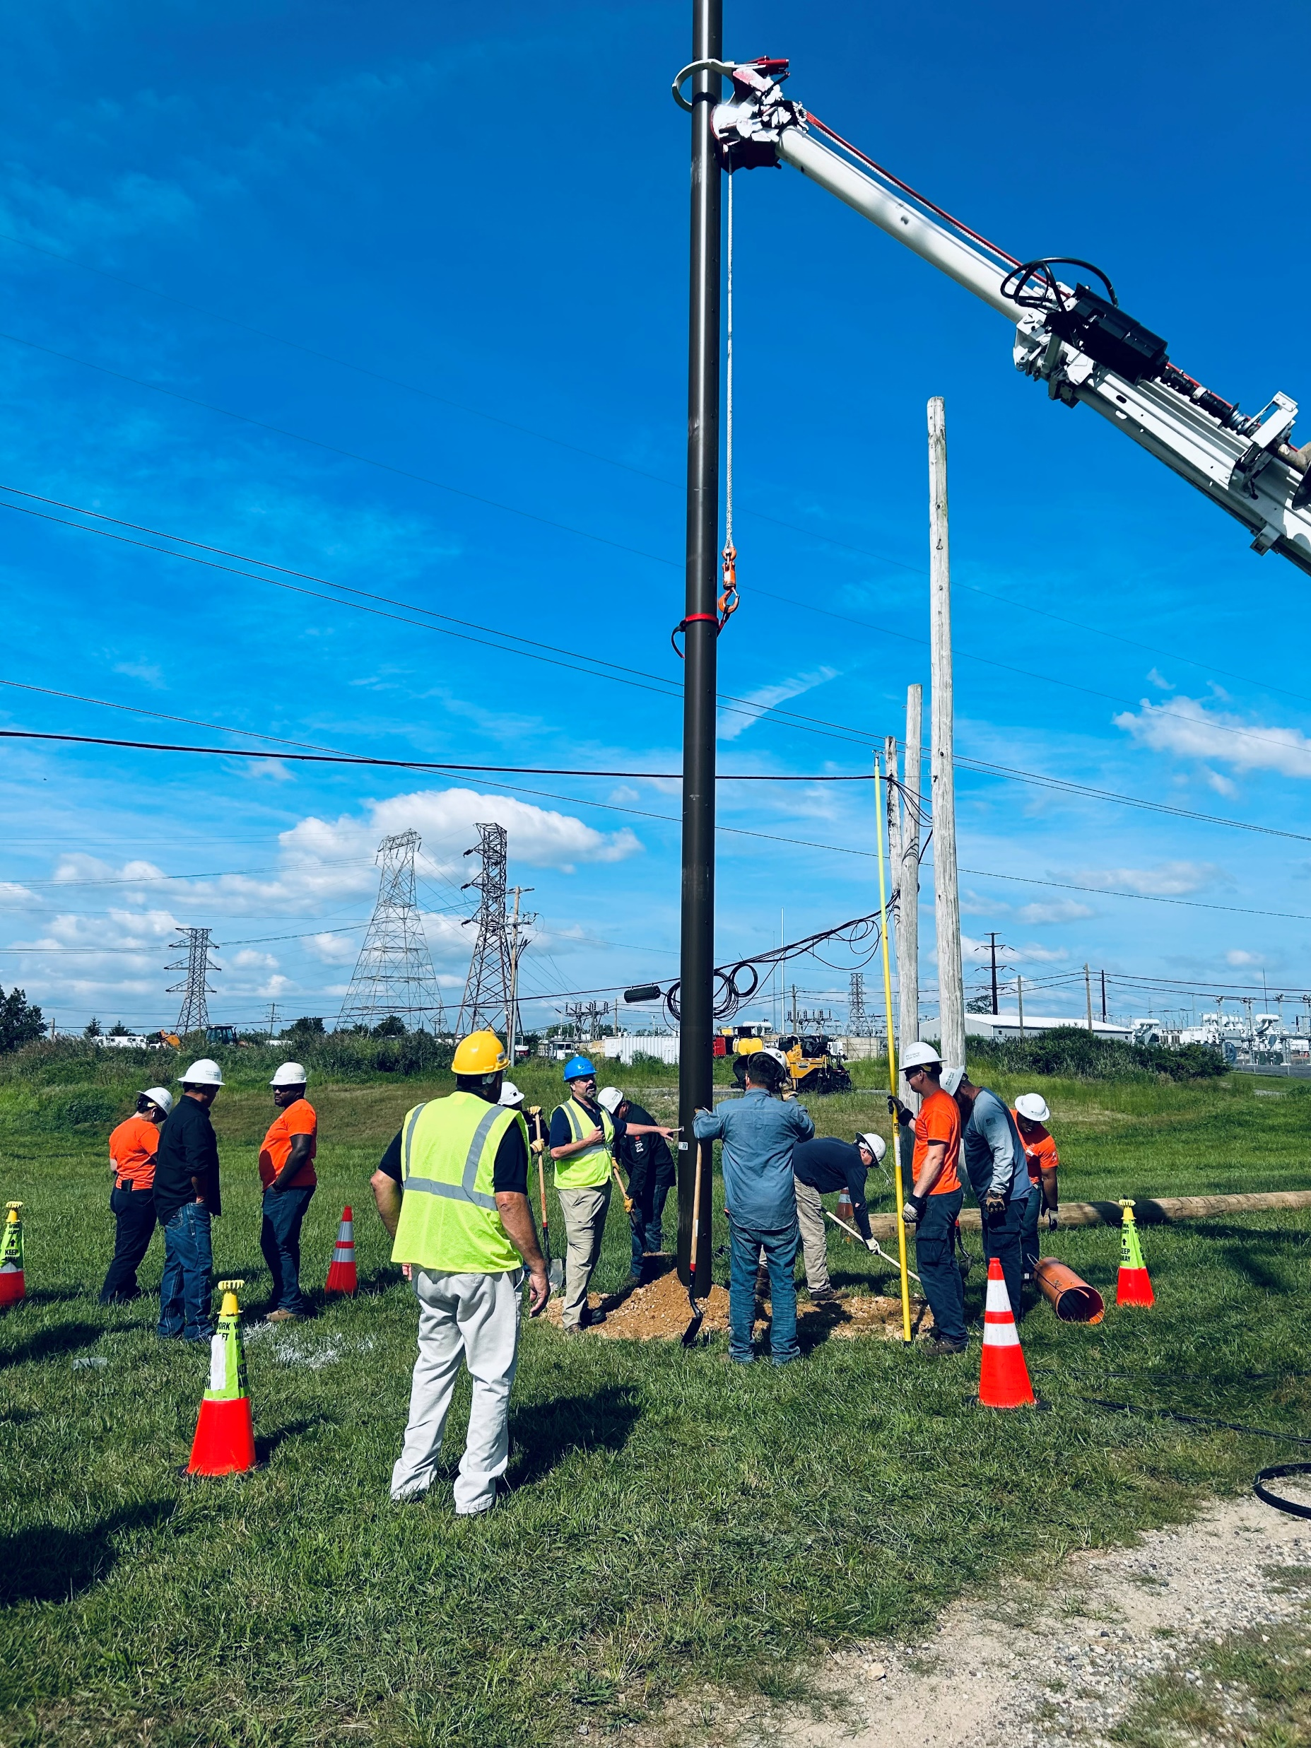
Fiberglass pole setting

Slide 19
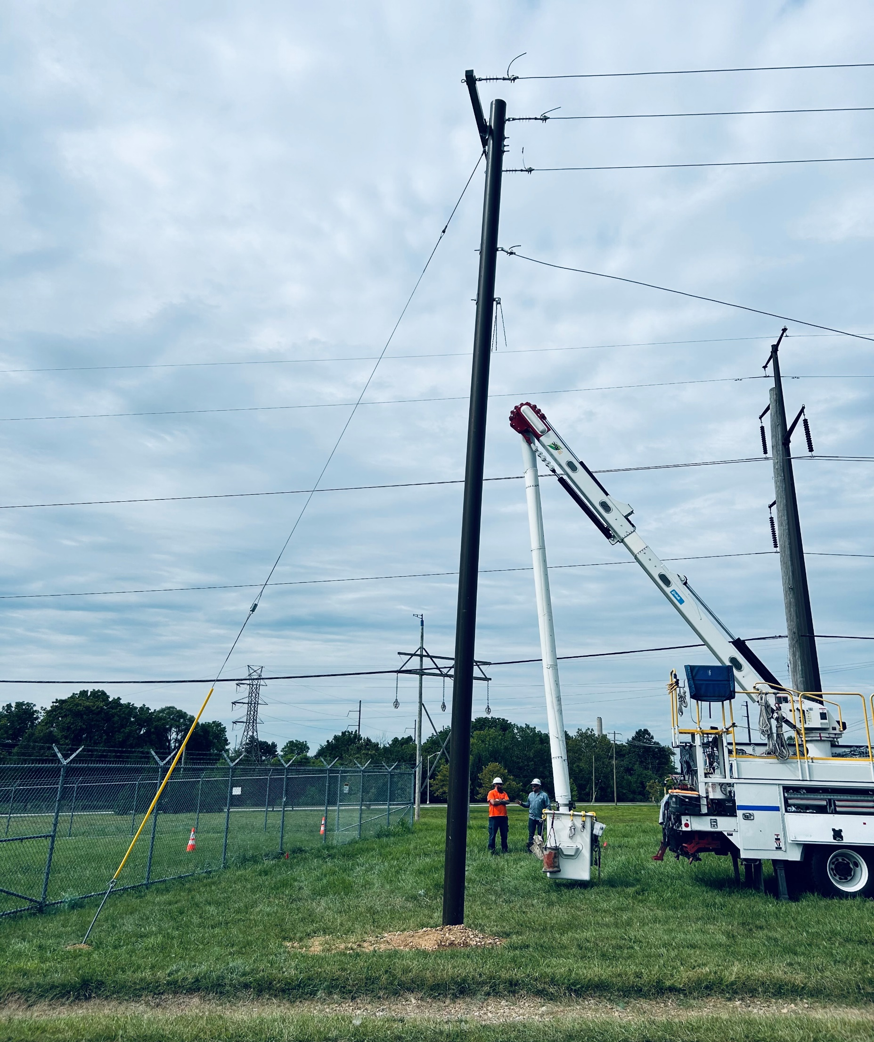
Fiberglass pole –
Dead-end application, 23” deflection from top of the pole to ground, while guyed

Slide 20
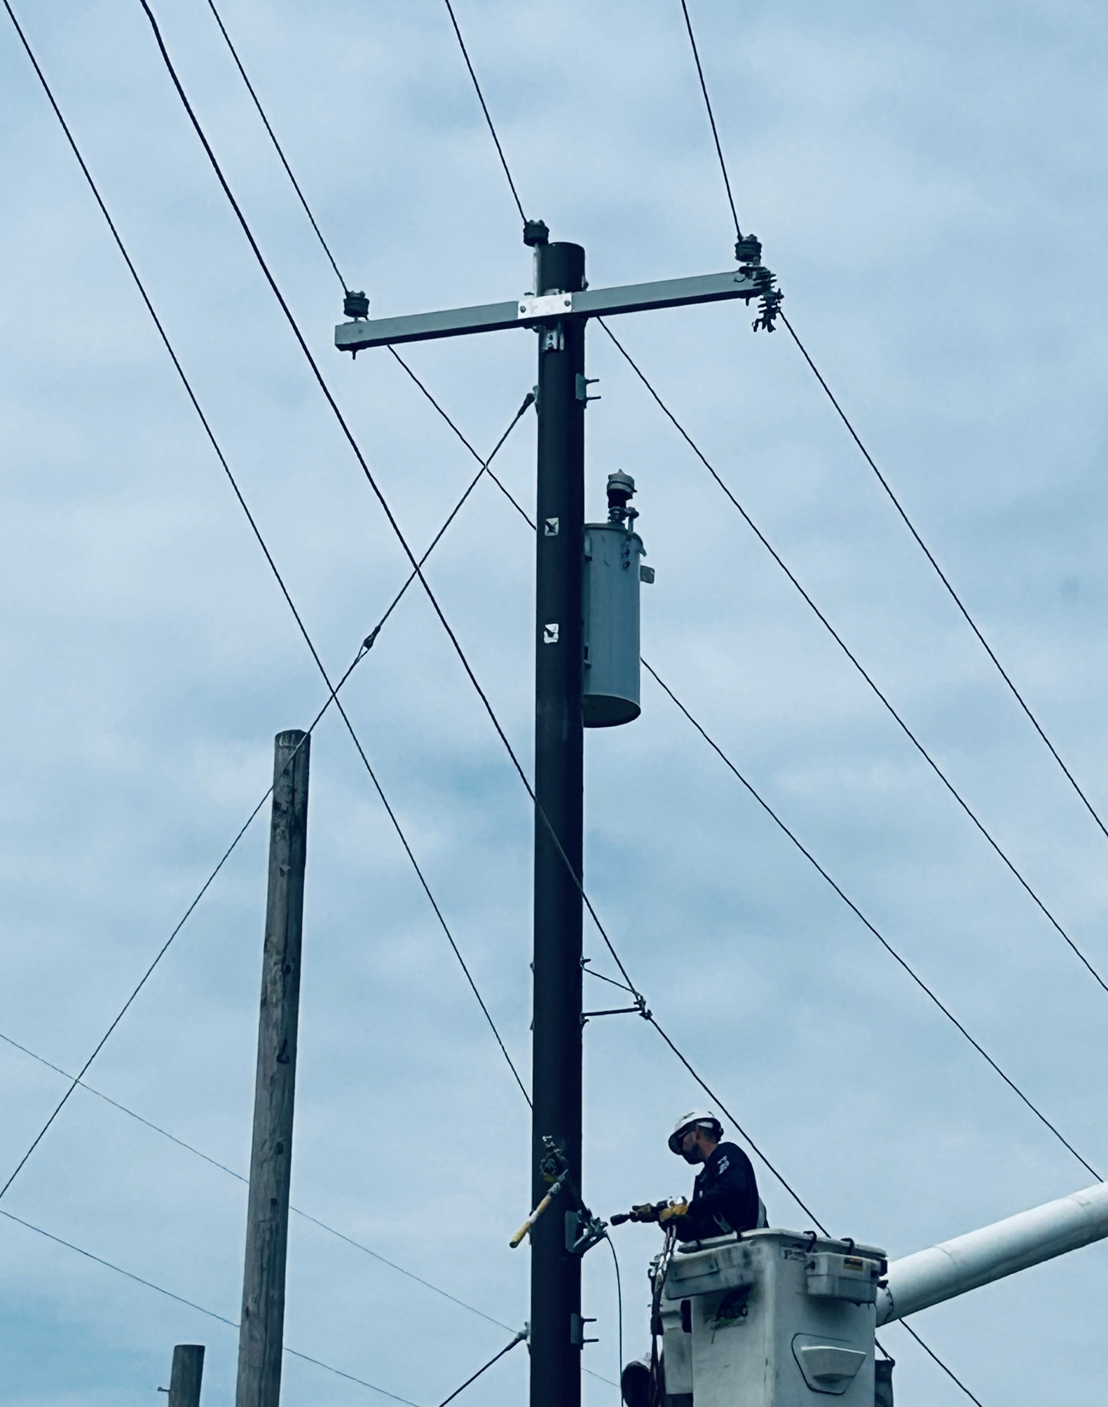
Fiberglass pole with transformer and fiberglass arm, polymer cutout and insulators; Ready for 60 years of life!
Cable bracket and messenger being installed.

Slide 21
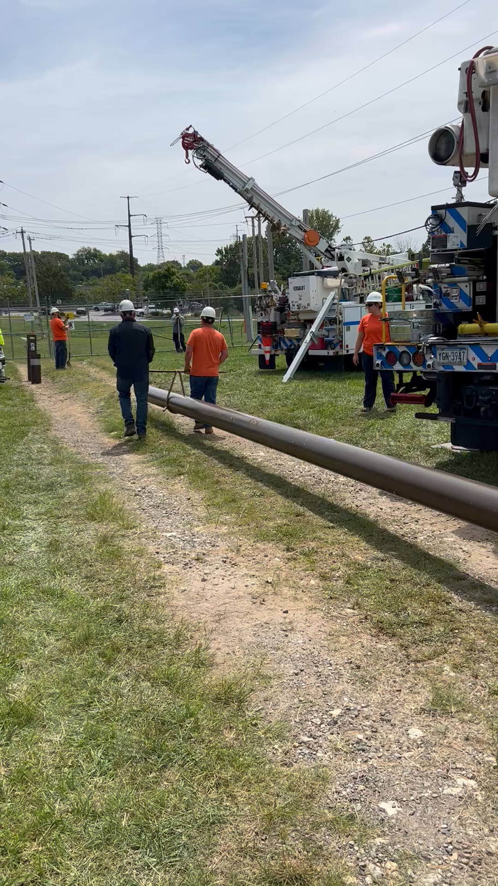
Fiberglass Pole - All Hands.pptx
It’s off to work we go!!!
FG pole weighs 450 lbs.

